Slide 1
Microsoft Power BI

Slide 2
Developing in Salesforce with Power BI Embedding
Ted Pattison
Principal Program Manager
Power BI Customer Advisory Team (PBICAT)

Slide 3
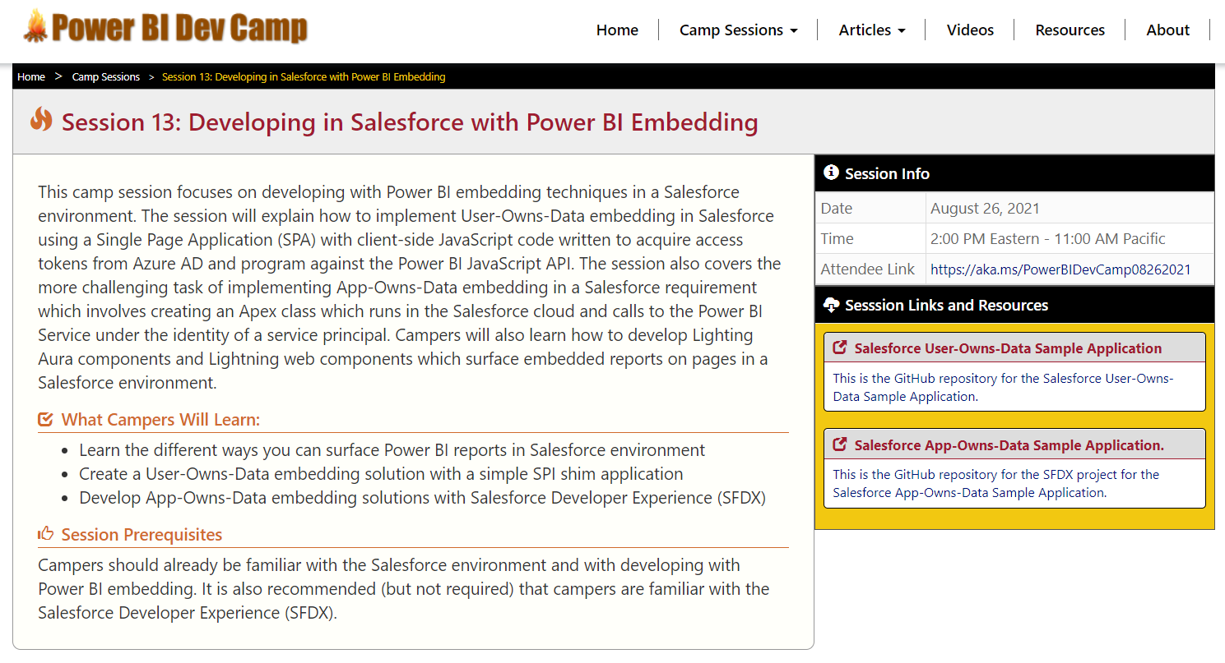
Welcome to Power BI Dev Camp
Power BI Dev Camp Portal - https://powerbidevcamp.net

Slide 4
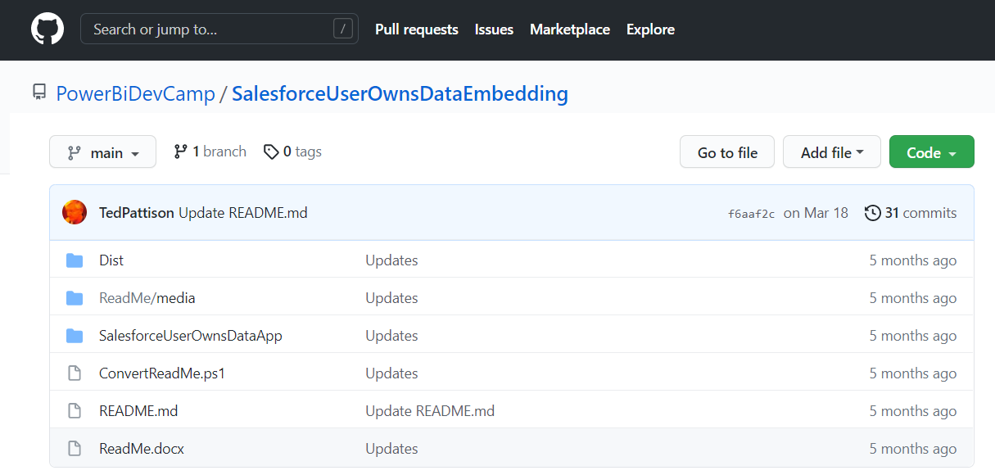
GitHub Repositories with Developer Sample Code
Simple solution for user-owns-data embedding
https://github.com/PowerBiDevCamp/SalesforceUserOwnsDataEmbedding
Pro dev solution using SFDX for app-owns-data embedding
https://github.com/PowerBiDevCamp/SalesforceAppOwnsDataEmbedding

Slide 5
Agenda
Overview Power BI Embedding in Salesforce
Surfacing Reports using Secure Embed
Creating an SPA Shim for User-Owns-Data Embedding
Creating Apps-Owns-Data Embedding Solution using SFDX

Slide 6
Options for Power BI Embedding Solutions in Salesforce
Simple solutions for user-owns-data embedding using iFrames
Use out-of-the-box Secure Embed feature
Create simple SPA shim with custom embedding logic
No need to customize Salesforce environment
Avoids complexity and cost of professional-level Salesforce development
No ability to implement app-owns-data embedding
Pro Dev solutions using Salesforce Developer Experience (SFDX)
Required for solutions which use app-owns-data embedding
Greater flexibility for solutions which use user-owns-data embedding
Requires SFDX skills for building/testing/deploying solutions

Slide 7
Agenda
Overview Power BI Embedding in Salesforce
Surfacing Reports using Secure Embed
Creating an SPA Shim for User-Owns-Data Embedding
Creating Apps-Owns-Data Embedding Solution using SFDX

Slide 8
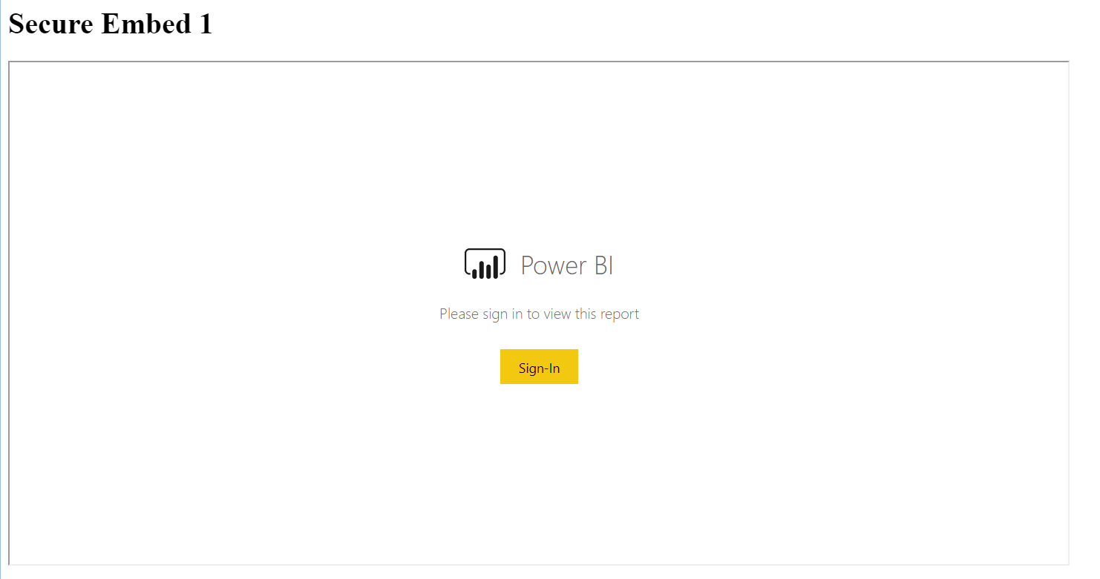
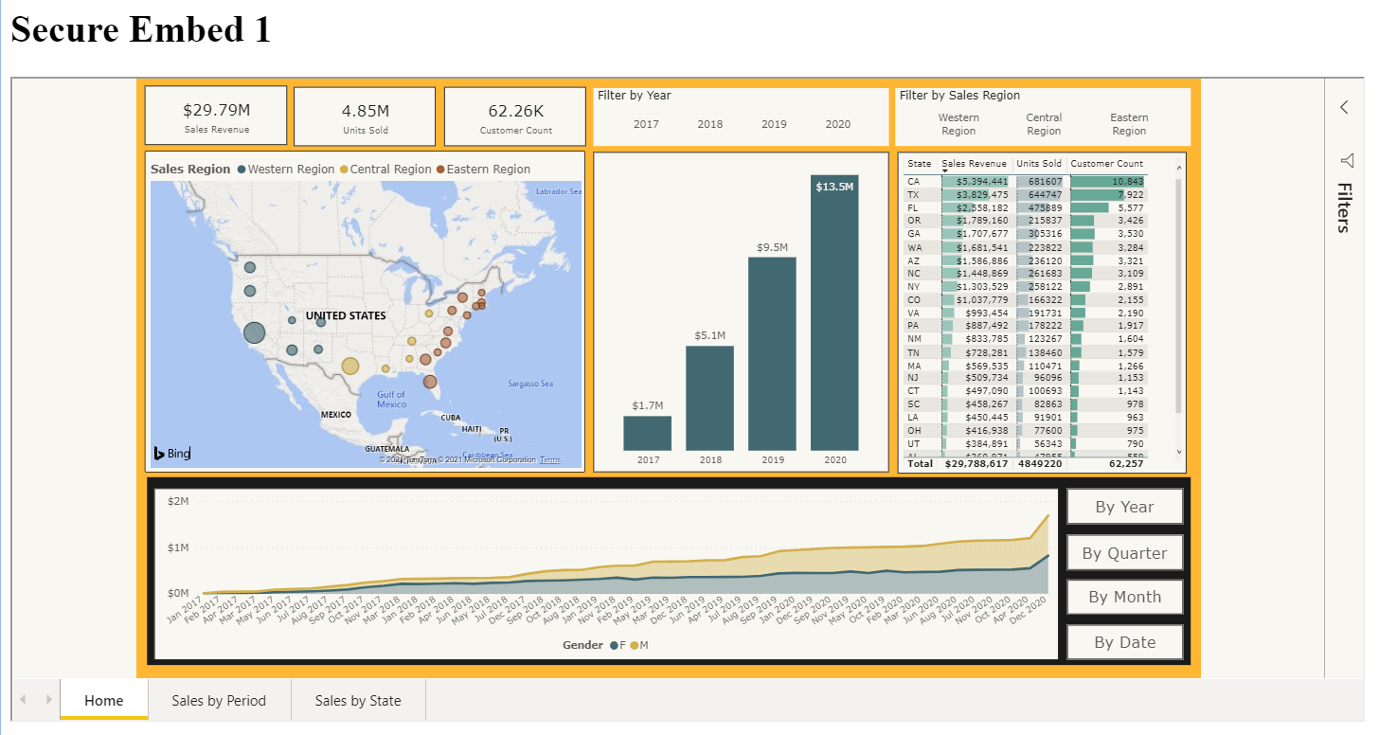
Surfacing Reports with Secure Embed
Secure Embed used to surface report with user-owns-data embedding
Eliminates need for any custom development
Configuration involves copying-and-pasting iFrame into Visualforce page

Slide 9
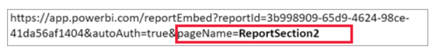
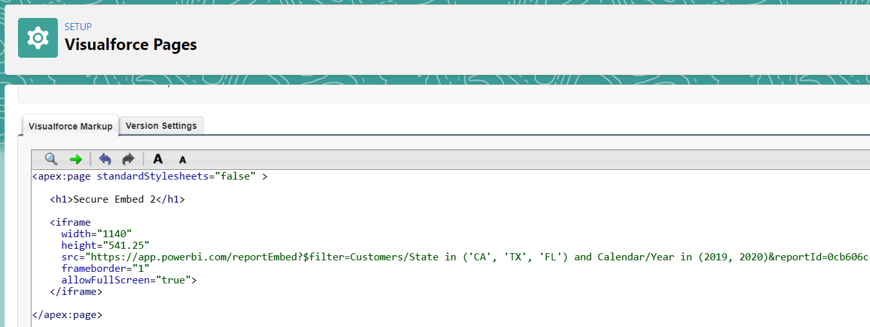
Customizing Secure Embed
Select page using pageName query string parameter
Apply filter using $filter query string parameter
Query string parameters added to URL for src attribute of iFrame

Slide 10
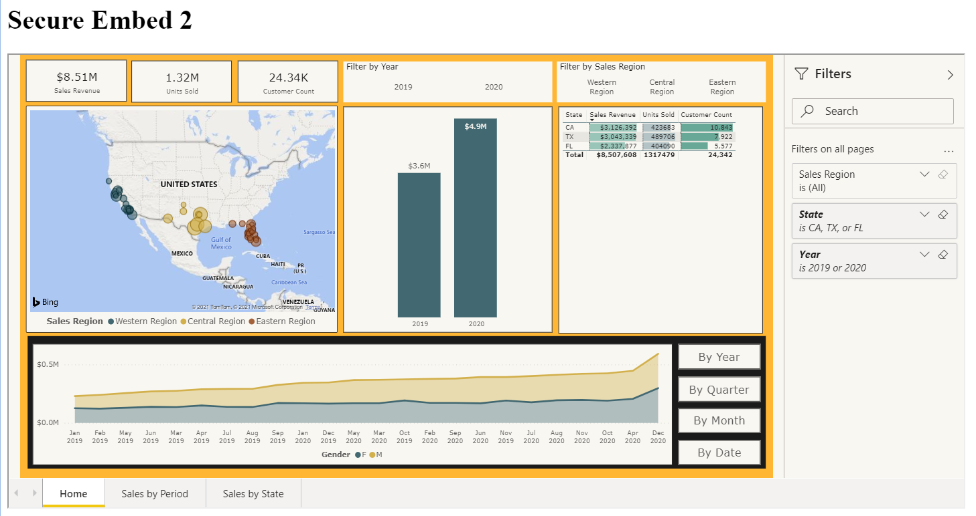
Power BI Report Surfaced using Secure Embed
Filter Pane
Page Navigation

Slide 11
Agenda
Overview Power BI Embedding in Salesforce
Surfacing Reports using Secure Embed
Creating an SPA Shim for User-Owns-Data Embedding
Creating Apps-Owns-Data Embedding Solution using SFDX

Slide 12
Creating a SPA Shim for User-Owns-Data Embedding
Provides more control and flexibility than using Secure Embed feature
Use white label loading by substituting custom animation for Power BI Logo
Control over page navigation – show | hide | bottom | left
Control Filter Pane – show | hide | expand | collapse
Control Bookmarks Pane - show | hide
Show Power BI Report Action Bar
Cache login credentials across sessions (limited to 24-hour period)

Slide 13
Steps to Deploy a Solution based on SPA Shim
To configure the SalesforceUserOwnsDataApp sample
Find a place to publish the application files where they're accessible through HTTPS e.g. - https://salesforceuserownsdataapp.azurewebsites.net
Create an Azure AD application for a Single Page Application (SPA) use https://salesforceuserownsdataapp.azurewebsites.net as the reply URL
Download the application files and configure app.js to use your clientId and tenant
Upload application files to publish location
Test embedding a Power BI report by going directly to the application's URL
Embed the report in Salesforce by adding iFrames to a VisualForce page

Slide 14
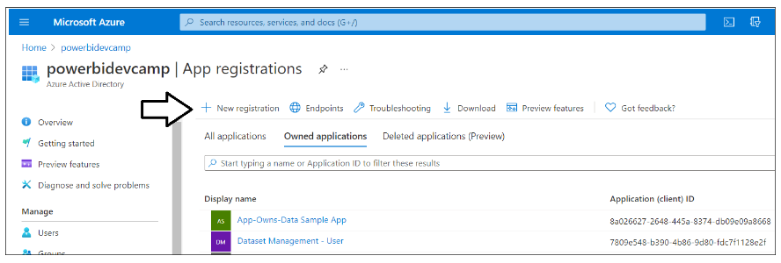
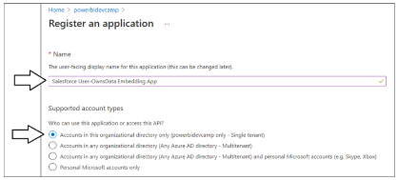
Creating an Azure AD Application for an SPA
Click New registration to create a new Azure AD application
Give the new Azure AD application a name and configure for internal users only

Slide 15
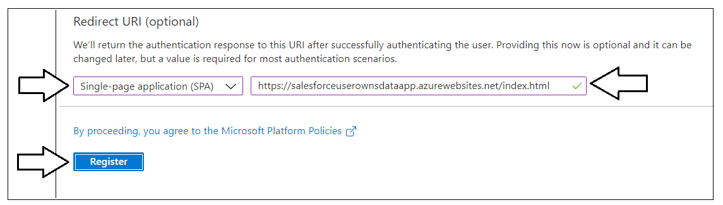
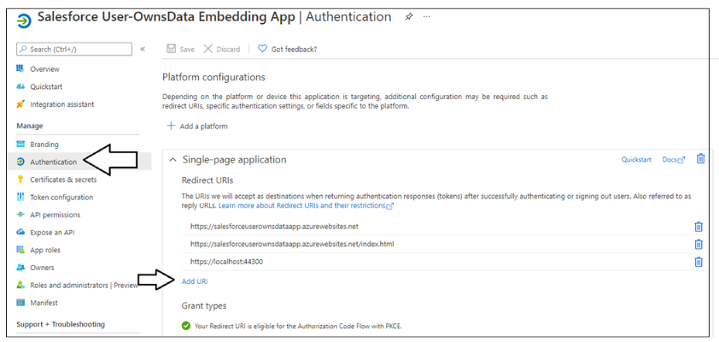
Configuring Azure AD Application as an SPA
Configuring an Azure AD application as a SPA
Requires configuring Redirect URI to page where sign-in occurs
Requires writing custom authentication code using msal-browser.js
After application is created, you can add as many redirect URLs as you’d like

Slide 16
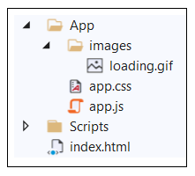
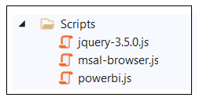
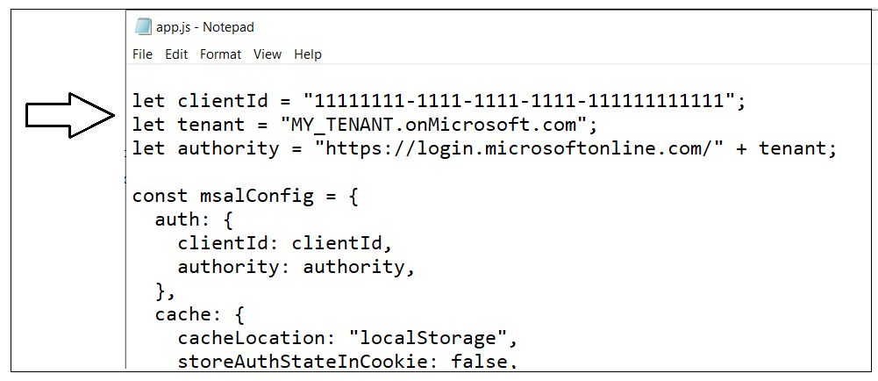
Source files included in SPA solution
Examine the structure of files for the solution
Open app.js and update clientId and tenant

Slide 17
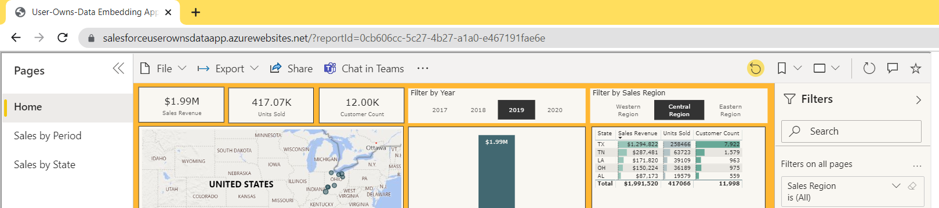
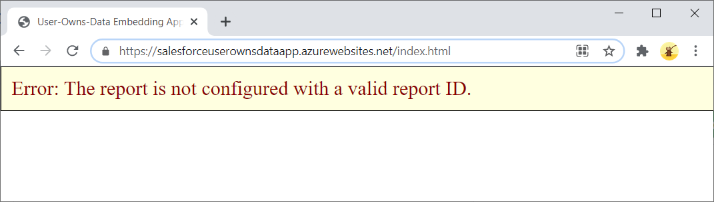
Passing Report ID as a Query String Parameter
Report ID must be passed as a query string named reportId
Report shows error message is reportId is not passed as query string parameter

Slide 18
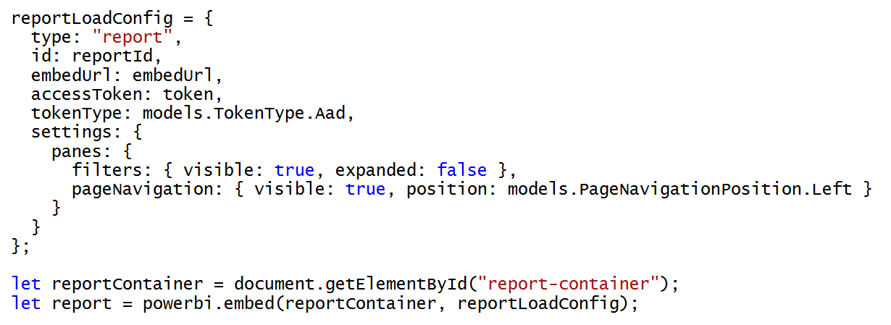
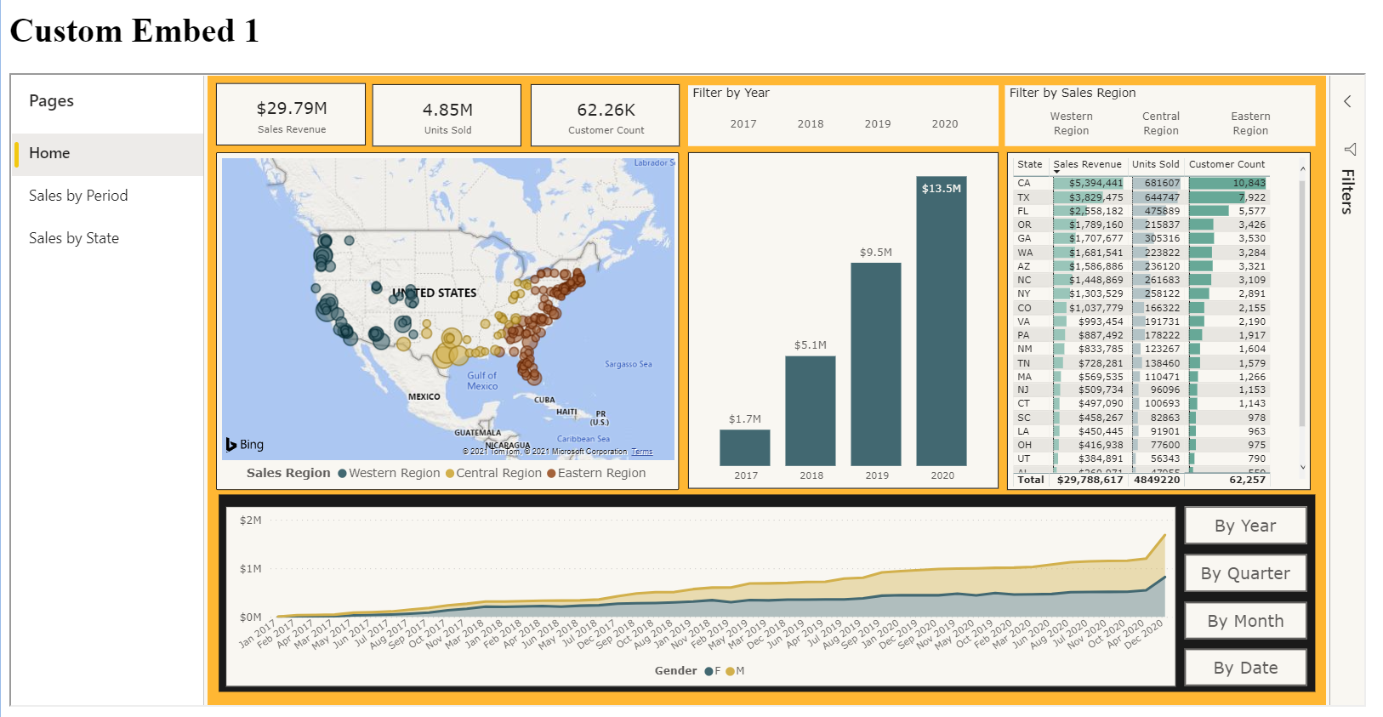
Example 1: Control Page Navigation and Filter Pane

Slide 19
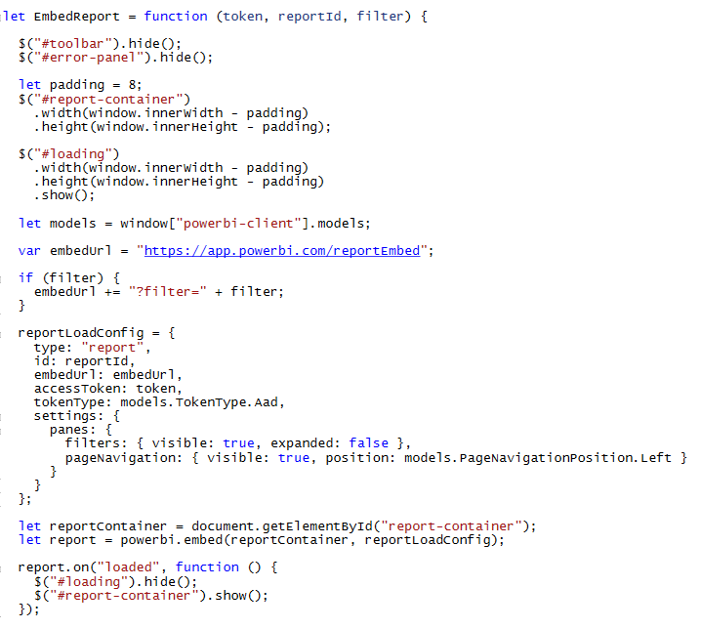
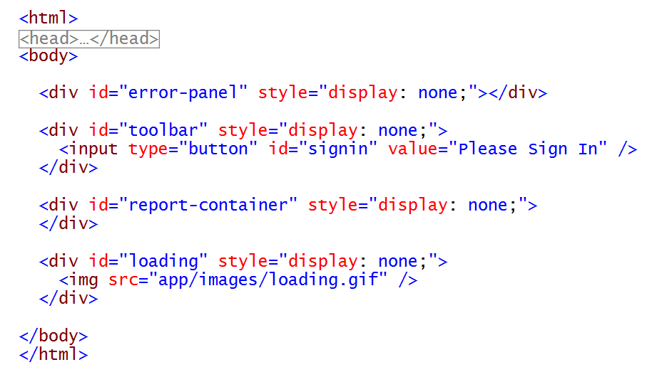
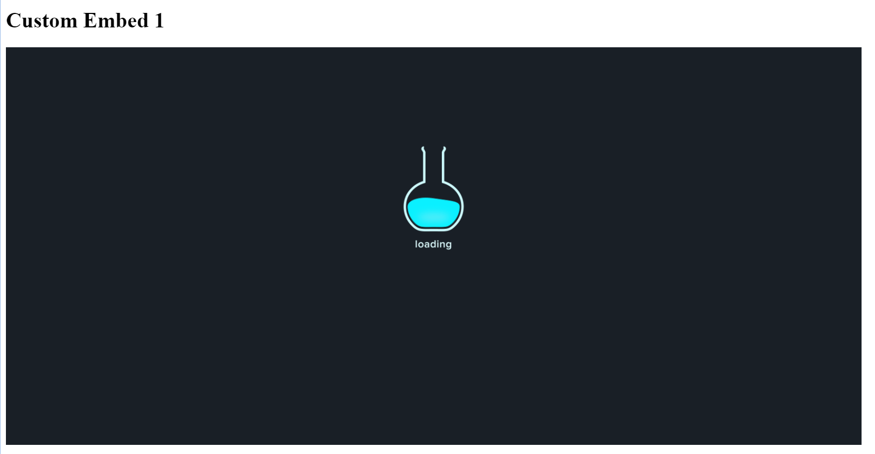
Walkthrough of White Label Loading

Slide 20
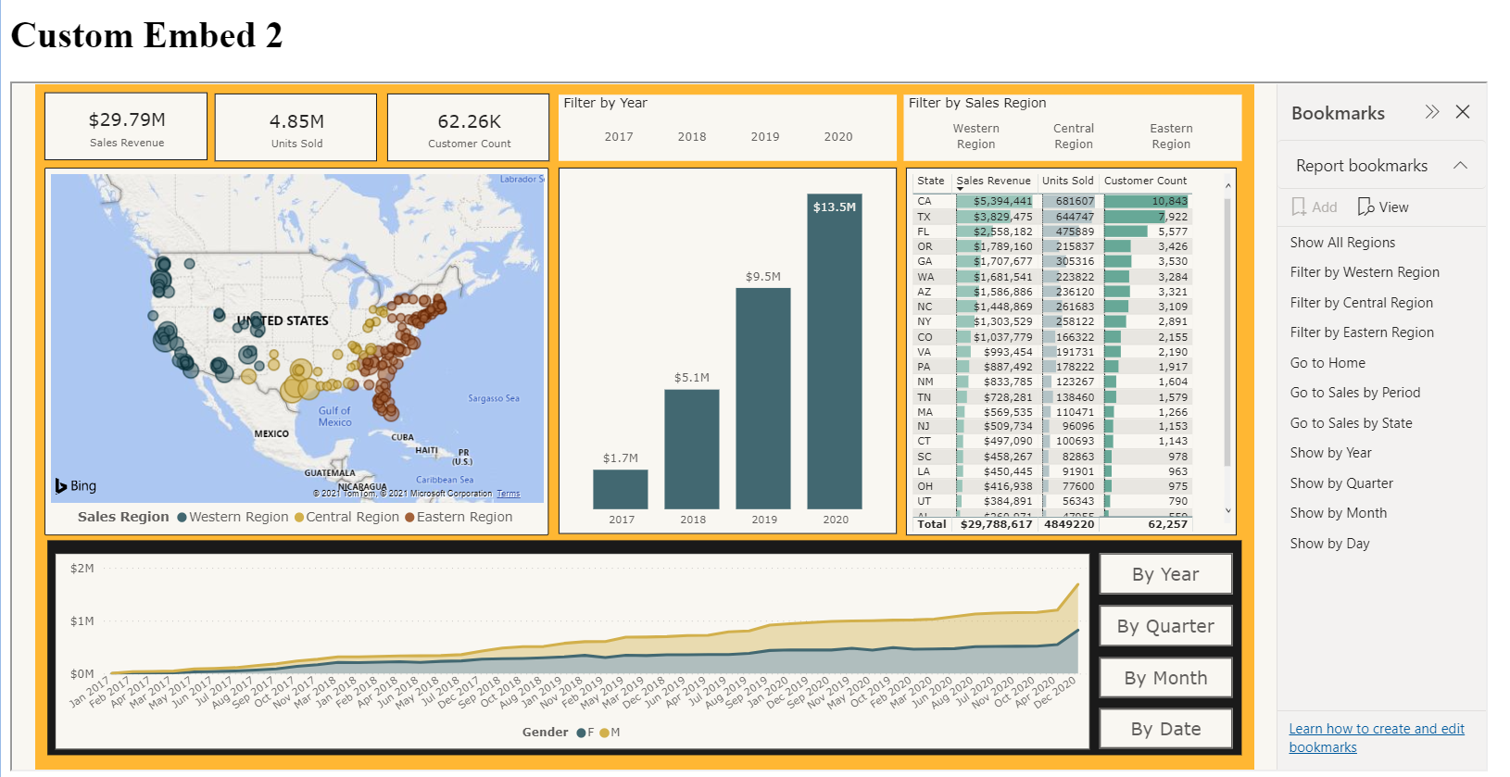
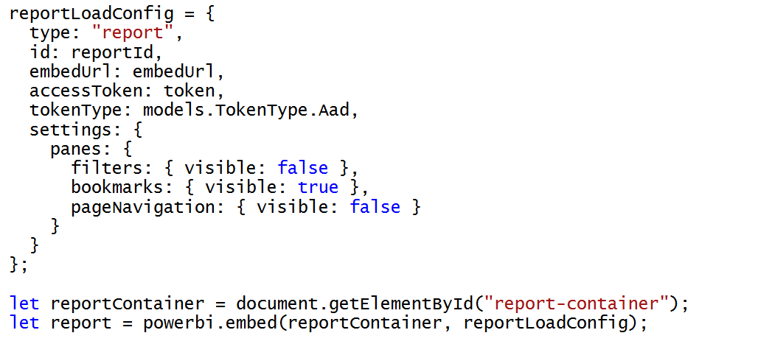
Example 2: Show Bookmarks Pane

Slide 21
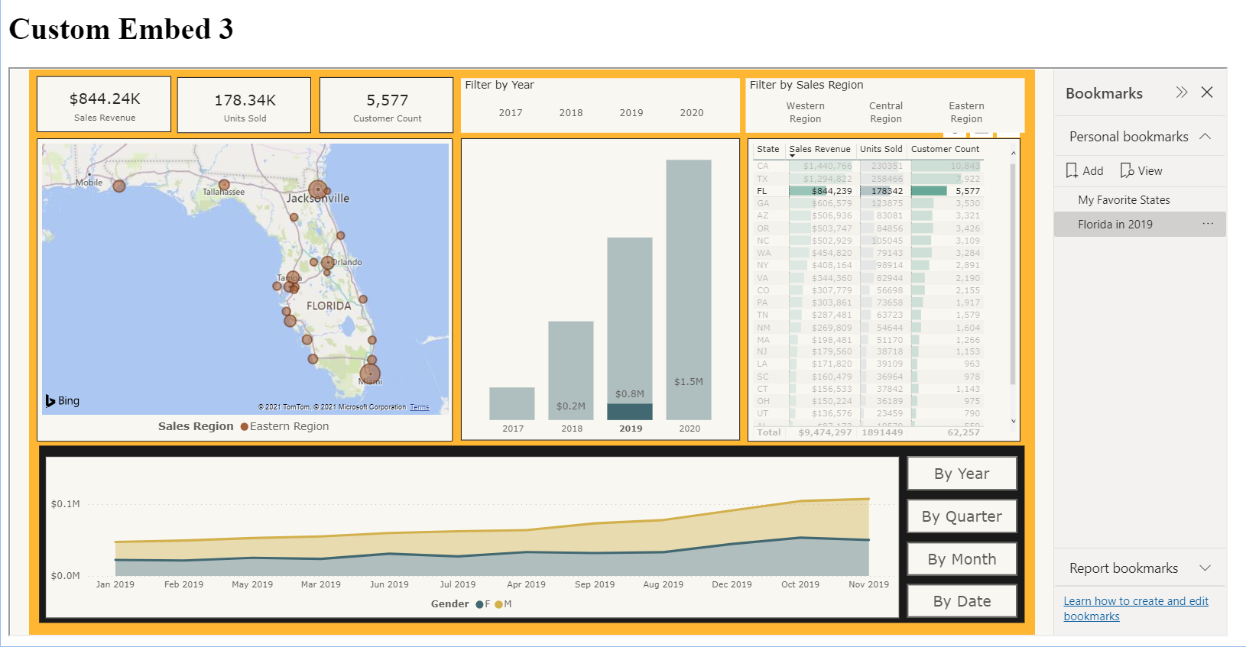
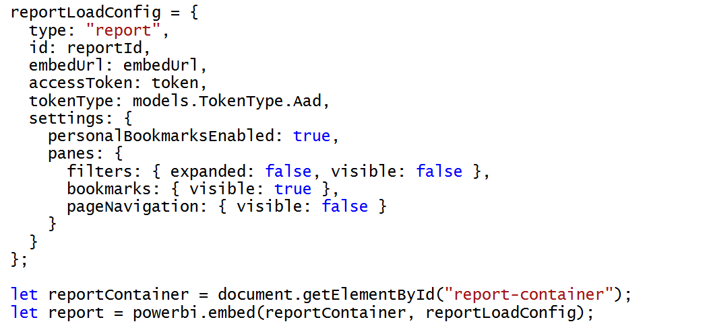
Example 3: Enabled Users to Create Personal Bookmarks

Slide 22
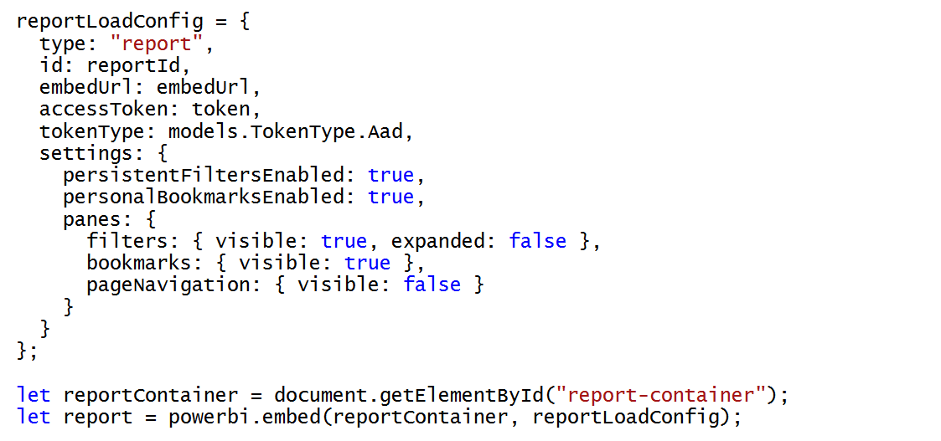
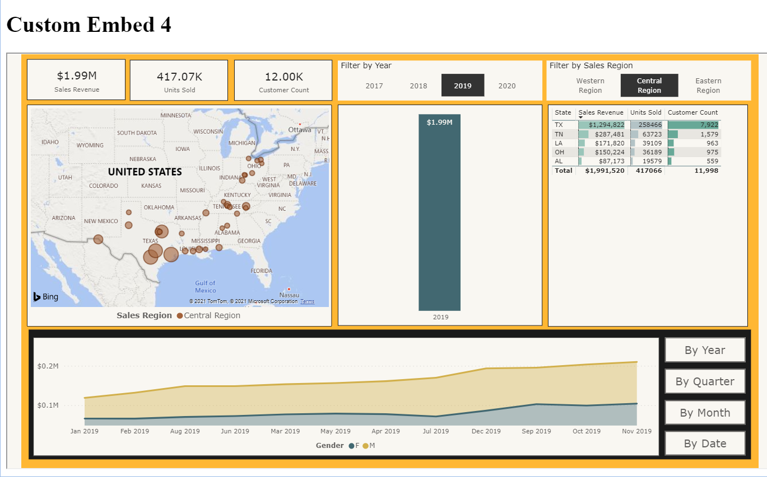
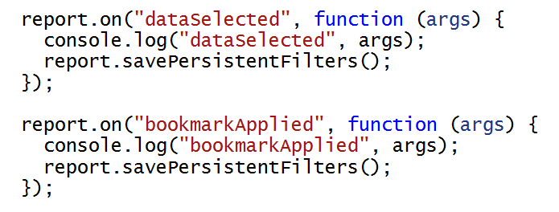
Example 4: Enabling Persistent Filters
Report can remember last filter setting for each user

Slide 23
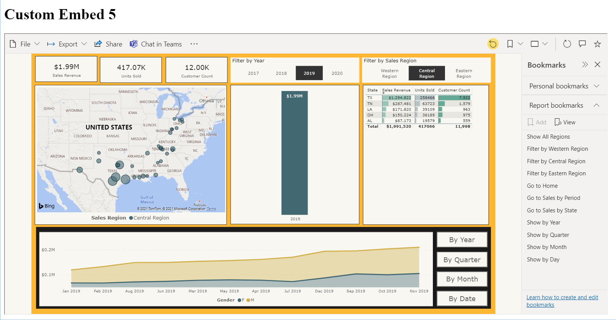
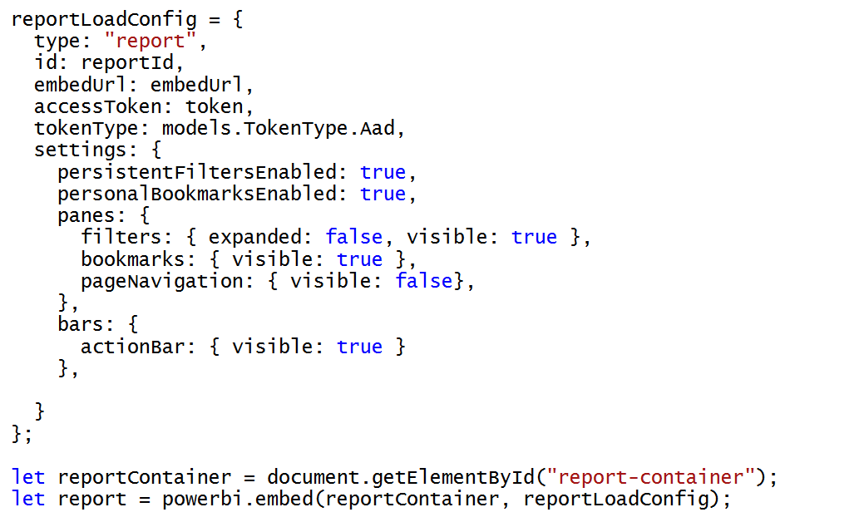
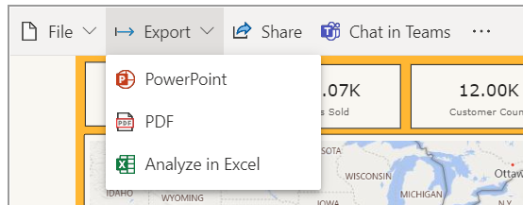
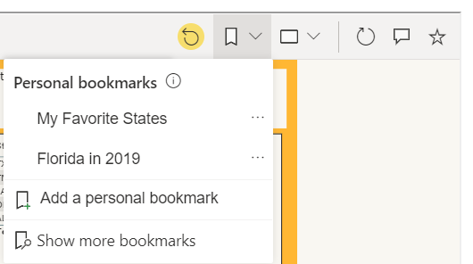
Example 5: Display the Action Bar

Slide 24
Agenda
Overview Power BI Embedding in Salesforce
Surfacing Reports using Secure Embed
Creating an SPA Shim for User-Owns-Data Embedding
Creating Apps-Owns-Data Embedding Solution using SFDX

Slide 25
What is SFDX?
Salesforce Developer Experience (SFDX)
Robust development platform for professional developers and ISVs
Provides Salesforce CLI and developer extensions in Visual Studio Code
Require significant developer effort to get up to speed on SFDX development
See https://developer.salesforce.com for more info
SFDX components used in the App-Owns-data developer sample
Apex classes
Lightning Aura components
Lightning Web components

Slide 26
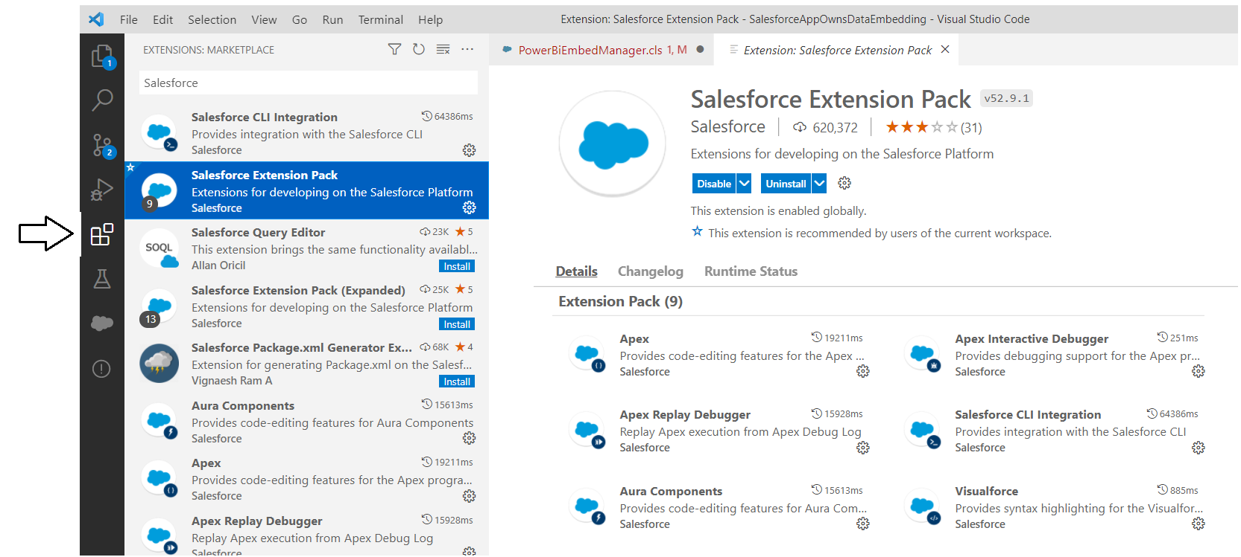
SFDX Development with Visual Studio Code
Install the Salesforce CLI
https://developer.salesforce.com/docs/atlas.en-us.sfdx_setup.meta/sfdx_setup/sfdx_setup_install_cli.htm
Add the Salesforce Extension Pack in Visual Studio Code

Slide 27
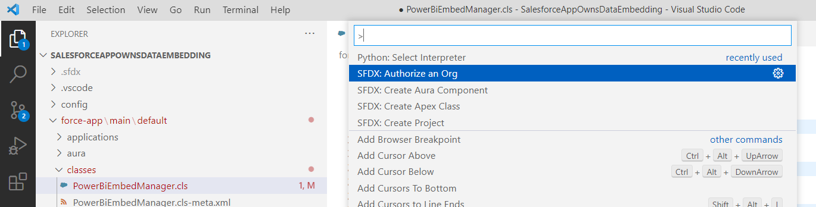
Executing SFDX CLI Commands using Command Palate
You can execute CLI commands using VS Code command palate (CTRL+SHIFT+P)

Slide 28
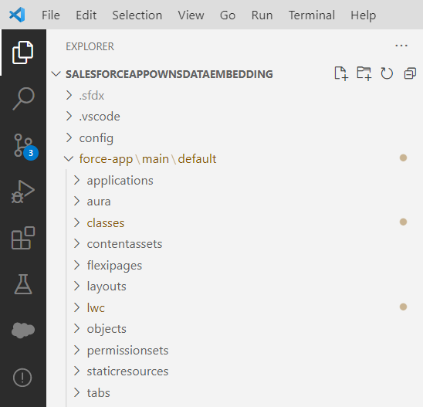
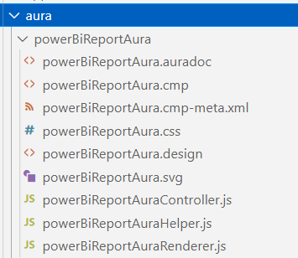
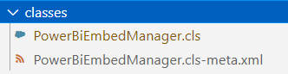
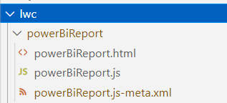
Working with SFDX Projects in Visual Studio Code
Lightning Aura Components
Apex Classes
Lightning Web Component

Slide 29
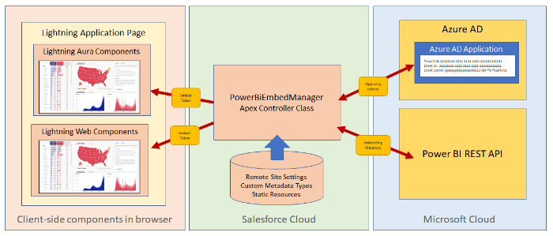
Solution Architecture
Solution built on top of Apex controller class named PowerBiEmbedManager
Apex code implements client credentials flow to acquire app-only access token from Azure AD
Apex code calls to Power BI REST API to get report metadata and embed token
Apex code passes view model back to browser with report metadata and embed token

Slide 30
Salesforce Configuration Requirements
Configuring the Salesforce App-Owns-Data Developer Sample
Add remote site settings for Azure AD and Power BI REST API
Create an Azure AD application to call the Power BI REST API
Create a custom metadata type to store client credentials for the Azure AD application
Create a static resource by uploading a copy of the Power BI JavaScript API (powerbi.js)

Slide 31
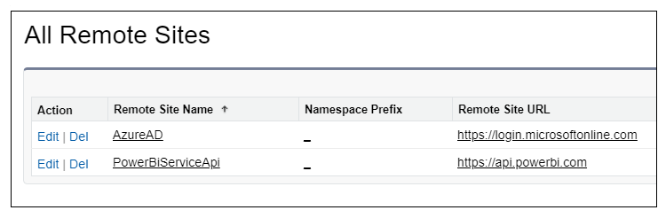
Remote Site Settings

Slide 32
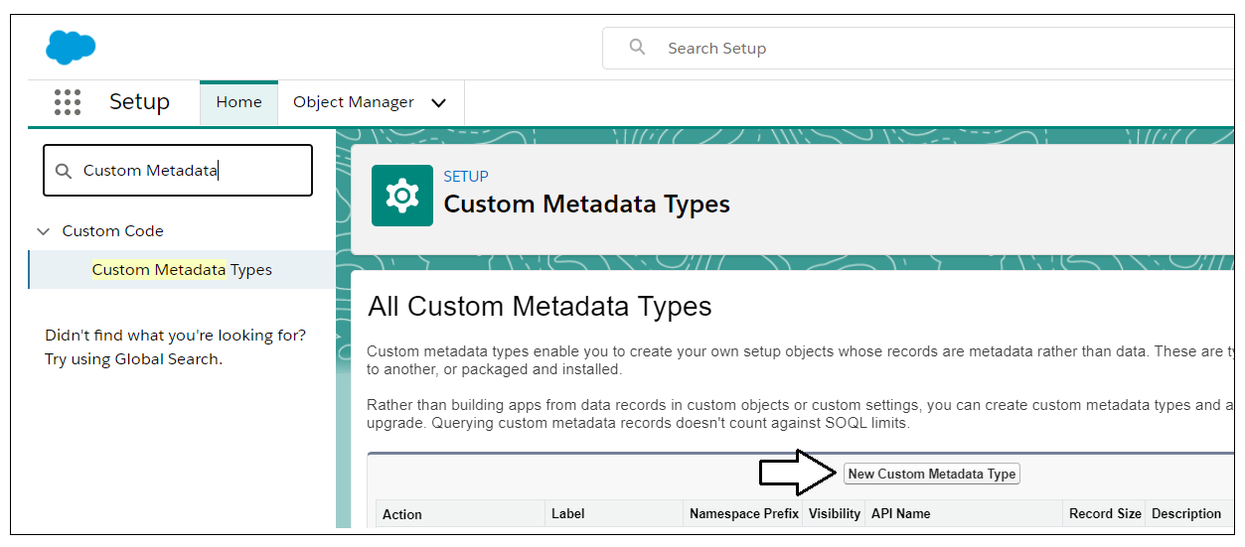
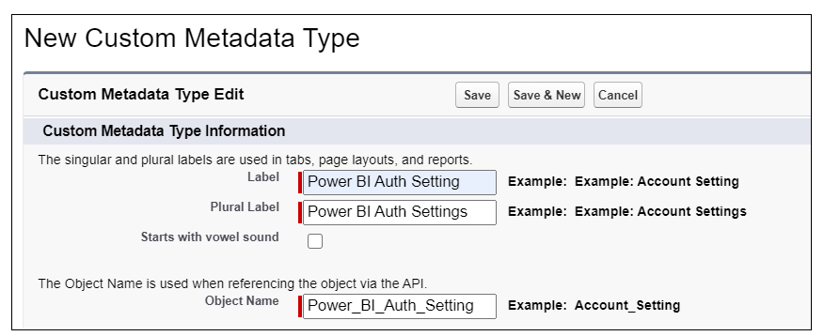
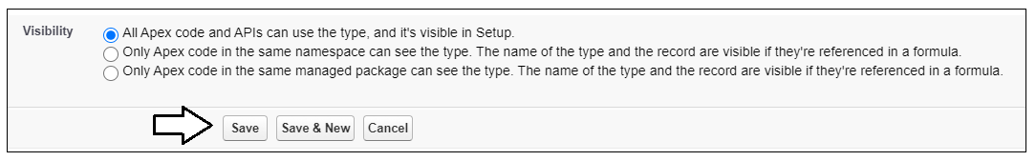
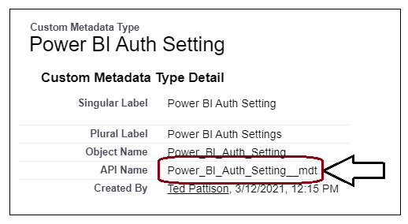
Use Custom Metadata Type to Track Client Credential

Slide 33
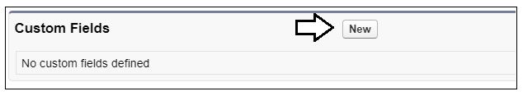
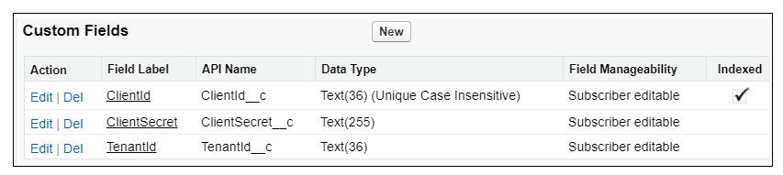
Add a Custom Metadata Type Fields

Slide 34
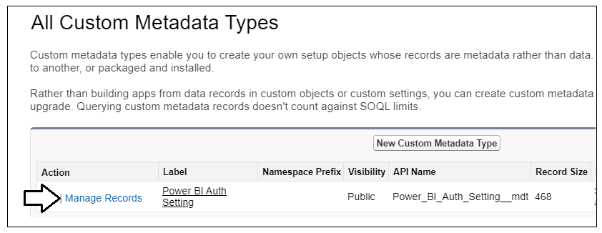
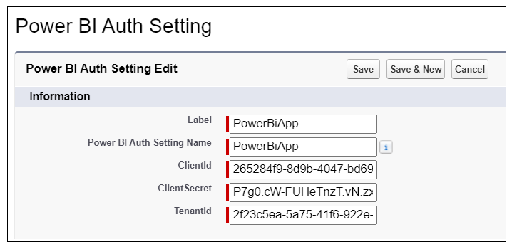
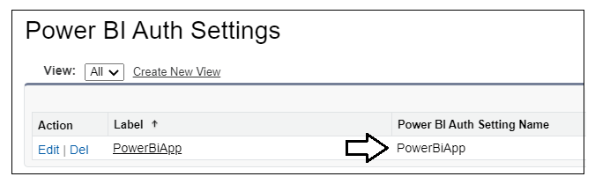
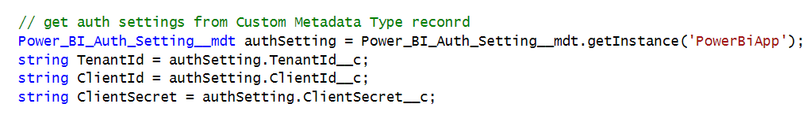
Add a Custom Metadata Type Instance

Slide 35

Implementing Client Credentials Flow

Slide 36



Upload powerbi.js as a Static Resource

Slide 37


Passing Workspace ID and Report ID to Apex Class
Components Is configured with Workspace ID and Report ID
Workspace ID and Report ID passed to Apex control class

Slide 38

Security in App-Owns-Data Embedding
Apex controller class returns view model with embed token

Slide 39

Salesforce Secure Locker Code Service
Powerbi.js cannot run inside Salesforce sandbox for Locker Service
Must configure component API version to disable sandbox

Slide 40
Summary
Overview Power BI Embedding in Salesforce
Surfacing Reports using Secure Embed
Creating an SPA Shim for User-Owns-Data Embedding
Creating Apps-Owns-Data Embedding Solution using SFDX

Slide 41
Questions Microsoft Power BI

